Slide 1
Multimedia distribution media
CD-ROMs*
Digital Versatile Discs*
World Wide Web
Computer*

Slide 2
Introducing the Internet
Internet History and Concepts
History of World Wide Web
Physical contents of WebPages
Application of WWW in Intranet and Extranet
New Applications of the Internet

Slide 3
Internet and World Wide Web History and Concepts
Hypertext
The internet
The World Wide Web

Slide 4
Hypertext
The Hypertext was originally conceived by Ted Nelson in the mid 1960s
– as a method for making computers to respond to the way humans think, require, and explore information
Way of creating linkages between related text
– Instead of reading all text, you could select a word in a sentence, information about that word is retrieved if it exists, or the next occurrence of the word is found
Is a special type of database object in which objects (text, pictures, music, programs) can be creatively linked to each other

Slide 5
Hypertext
When you select an object you can see all the other objects linked to it
You can move from one object to another on different forms .
The most frequently used form of Hypertext document contains automated cross references to other documents called Hyperlinks

Slide 6
Hypertext
Selecting the Hyperlink causes the computer to load and display the other linked document
  – Relative links: links pages on the same server
  – Absolute links: links pages of completely different servers
  – Dead links: page could have moved to other servers
The most famous implementation of Hypertext is the World Wide Web

Slide 7
Hypertext
Hypertext systems are particularly useful for organizing and browsing through large databases that consist of different types of information including tables, images, and other presentational devices
Several Hypertext (authoring) systems were initially available for Apple Macintosh computers and PCs for developing databases
    – Hypercard software from Apple was one of the most famous tools
    – But now it is the World Wide Web
[Further Reading: Definition of Hypermedia]

Slide 8
Internet: Definition and Origins
A World Wide system of millions of interconnected computer networks, communicating by means of TCP/IP and associated protocols
Originally traced to the creation of ARPANET (Advanced Research Projects Agency Network) by the U.S. Department of Defense, 1969 (in response to the Russian Sputnik project)

Slide 9
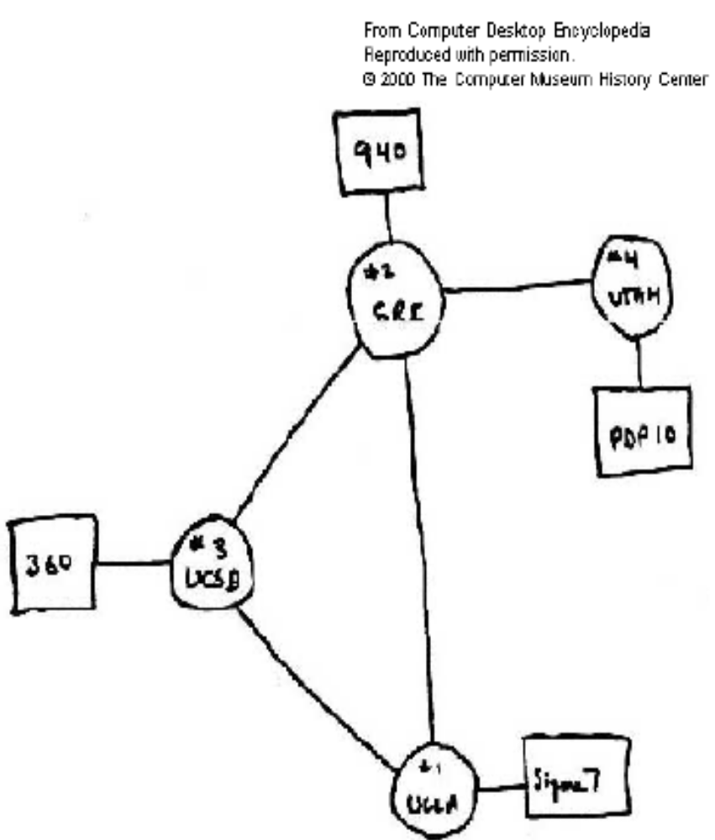
Internet: Origins
The four nodes in image 1 were
drawn in 1969 showing the
University of California at Berkeley,
Los Angeles, SRI International, and
the University of Utah. This modest
network diagram was the beginning
of ARPANET and eventually the
INTERNET.
(Image: Courtesy of the Computer
History Museum,
http://www.historycenter.org )

Slide 10
Internet: Technology
Transmission Control Protocol (TCP) and Internet Protocol (IP) is the principle communication tool for the internet
TCP/IP is a set of communication protocols that enables cooperating computers to share resources across networks
TCP/IP establishes standards and rules for messages sent through the networks
Important TCP/IP services are file transfer, remote login, and mail transfer
[Further Reading: Internet Protocol Suite including the different services provided to users]

Slide 11
Internet: DNS
The addressing system on the Internet generates IP addresses, indicated by numbers such as 128.201.86.290
Numbers are difficult to remember. So a user friendly system has been created: Domain Name System (DNS)
DNS system provides the equivalent mnemonic of a numeric IP address and ensures that every site on the internet has a unique address

Slide 12
Internet: Who owns it?
No single organization owns it!
It comprises of individual networks paid for separately
Several organizations play a role:
  1. Internet Society
  2. Internet Architecture Board (IAB)
  3. Internet Engineering Task Force (IETF)
  4. World Wide Web Consortium (W3C)
  5. Internet Corporation for Assigned Names and Numbers (ICANN)
  6. Registrars
  7. Internet Service Providers (ISPs)

Slide 13
Internet: Who owns it?
Internet Society
  – A private non profit organization that supports the work of the Internet Architectural Board
Internet Architectural Board
  – Handles architectural issues
Internet Engineering Task Force
  – Oversees how the Internet’s IP / TCP protocols evolve (http://www.ietf.org)

Slide 14
Internet: Who owns it?
World Web Consortium (W3C)
  – Develops industry standards for the evolution of the WWW
  – It is run by the Laboratory for Computer Science at MIT
Registrars
  – Companies co-operating to ensure that a particular domain is not duplicated
Internet Service Providers (Internet Access Providers)
  – Offer access to the Internet. Some have networks of their
  own

Slide 15
The World Wide Web
Tim Berners-Lee’s Vision
  1. He envisaged a collection of useful related resources,
  interconnected via hypertext links, dubbed the “Web of
  Information”
  2. Making it available on the Internet produced what Tim Berners-Lee first called the World Wide Web in the early1990s
  3. The first to combine hypertext and the Internet

Slide 16
The World Wide Web
A system of servers supporting documents specifically formatted in a markup language called HTML (Hyper Text Mark up Language)
HTML supports links to other documents as well as: graphics, audio, and video files
Not all Internet servers are part of the WWW

Slide 17
The World Wide Web
The World Wide Web combines four basic ideas:
  Hypertext
  Resource Identifiers:
    Unique identifiers used to locate a particular resource on the Internet
  The Client-Server model:
    System where the client software / computer sends requests to the server software / computer for services like files or data
  Markup Language

Slide 18
The WWW is not the Internet
The WWW is not synonymous with the Internet
The WWW is just a service that is available via Internet just like email that uses SMTP and other Internet services
The WWW is just a way of accessing information over the medium of the Internet
URIs enable documents to be accessed, identified, and cross referenced
[Further Reading: Uniform Resource Identifier: i.e. with regard to Uniform Resource Locator (URL) and Uniform Resource Name (URN)]

Slide 19
HTML
In computing, HyperText Markup Language (HTML) is a markup language designed for the creation of web pages with hypertext and other information to be displayed in a web browser.

Slide 20
Hypertext
The ability of the language to link one page to another (it uses hyperlinks).
We shall see HTML supporting links from one page to another and thus facilitating the concept of creating a website( A collection of intertwinned pages).

Slide 21
Markup
A markup language combines text and extra information about the text.
The extra information, for example about the text's structure or presentation, is expressed using markup, which is intermingled with the primary text.

Slide 22
Language
Control the behavior of a machine (often a computer). Languages have syntactic and semantic rules used to define meaning.
A language facilitates communication about the task of organizing and manipulating information precisely.
Programming languages also allow humans to communicate instructions to machines.

Slide 23
Web Browser
A web browser is a software application that enables a user to display and interact with text, images, and other information typically located on a web page at a website on the World Wide Web or a local area network.

Slide 24
Web Browser
Web browsers available for personal Computers include Microsoft Internet Explorer, Mozilla Firefox, Apple Safari, Netscape and Opera.

Slide 25
Introduction to HTML
Start, Programs, Accecories, Notepad.
<HTML>
</HTML> Each one of those is called a tag. There is a starting tag and a closing tag.
Tags as it were “talk” to the browser, or give it instructions.

Slide 26
Basic html
Every HTML document needs a pair of HEAD tags.
<HTML> <HEAD> </HEAD> </HTML>
The only thing we have to concern ourselves with in the HEAD tags (for now) are the TITLE tags.
<HTML><HEAD><TITLE></TITLE></HEAD>

Slide 27
Basic html
And the bulk of the page is going to be within the BODY tags.
<HTML>
<HEAD>
<TITLE>
</TITLE>
</HEAD>
<BODY>
</BODY>
</HTML>

Slide 28
Basic html
<HTML>
<HEAD>
<TITLE> We can learn anything! </TITLE>
</HEAD>
<BODY> Let us begin with HTML! </BODY>
</HTML>
Now save it, not as a text document, but as a html document.

Slide 29
Basic html
<HTML>: tells the Web browser that this is the beginning of an HTML document
<HEAD>: tells that Web browser that this is the header for the page (you'll learn later what goes between "HEAD" tags)
<TITLE>: tells the Web browser that this is the title of the page
<BODY>: tells the Web browser that this is the beginning of the Web page content -- everything you want to say and see on your page will follow this tag.

Slide 30
Saving
File then Save As.
You will be presented with a dialog box.
Make a new folder
Name it whatever you want. Then double click on it to open it up.
Where it says File name: type in "page1”.html Where it says Save as type: make sure it says All Files(*.*)
You should be able to double click on it now and see the results

Slide 31
Basic html
Find the icon of the html file you just made and double click on it
Or In Internet Explorer, click on File/Open File In Browser and browse to the file
What you made is a skeleton HTML document. This is the minimum required information for a web document and all web documents should contain these basic components.
And, the document title is what appears at the very top of the browser window.

Slide 32
Thank You All

